Slide 1
Lab 8 – Weather and Air Quality
Adapted from Lindsey Rodio
aosc.umd.edu/~hmdaley/AOSC201/

Slide 2
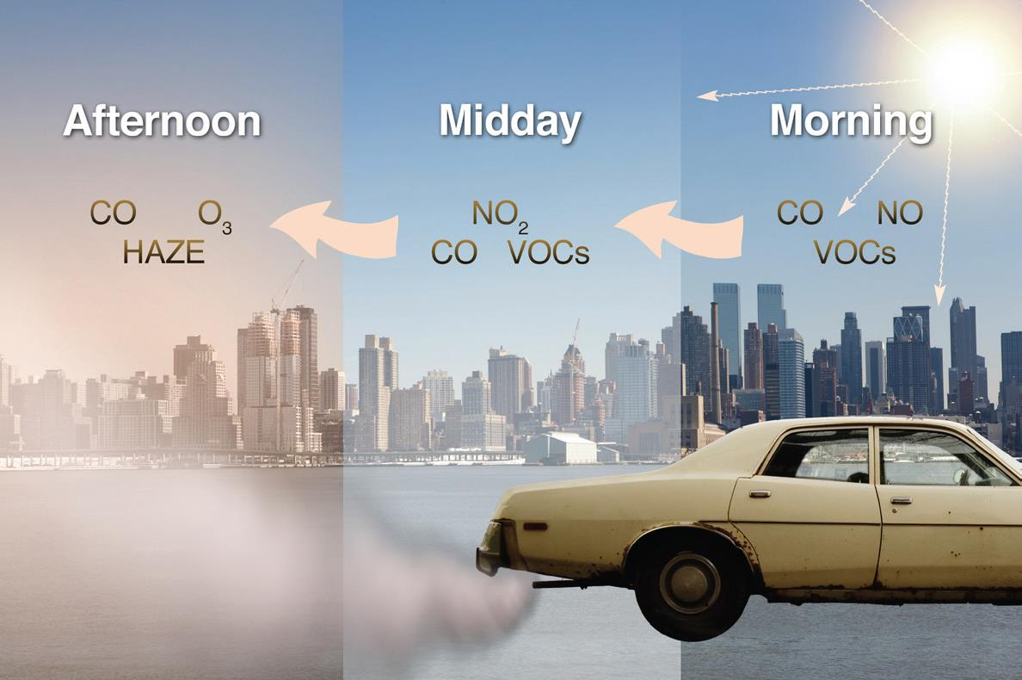
Tropospheric Ozone
2015 National Ambient Air Quality Standards (NAAQS): 70 ppb at an 8-hr avg
2008: 75 ppb for 8-hr avg
1997: 80 ppb for 8-hr avg
1979: 120 ppb for 1-hr avg
Produced by reactions with sunlight, natural gases, and incomplete combustion reaction products
Peaks mid-afternoon
Destroyed or dispersed by nitric oxide, titration, wind transport, etc.
Photochemical smog diurnal evolution
NO₂ + hv → NO + O
O + O₂ + M → O₃ + M
NO + O₃ → NO₂ + O₂
Ozone production and destruction with no hydrocarbons
Notes:
One of six criteria pollutants for the NAAQS (air quality standards set by the EPA after the implementation of the clear air act… originally proposed in 1970 but most recent revisions started standards called the NAAQS)
Other five criteria pollutants: lead, carbon monoxide, sulfur dioxide, nitrogen dioxide, PM
New levels set in 2015. Case study had higher exceedance level.

Slide 3
Tropospheric Ozone
Known to create a great deal of respiratory issues in plants and humans alike
O₃ diurnal cycle: surface heating begins and interacts with exhaust products to produce ozone towards the afternoon
Commonly referred to as photochemical smog
Photochemical smog diurnal evolution
NO₂ + hv → NO + O
O + O₂ + M → O₃ + M
NO + O₃ → NO₂ + O₂
Ozone production and destruction with no hydrocarbons
Notes:
One of six criteria pollutants for the NAAQS (air quality standards set by the EPA after the implementation of the clear air act… originally proposed in 1970 but most recent revisions started standards called the NAAQS)
Other five criteria pollutants: lead, carbon monoxide, sulfur dioxide, nitrogen dioxide, PM
New levels set in 2015. Case study had higher exceedance level.

Slide 4
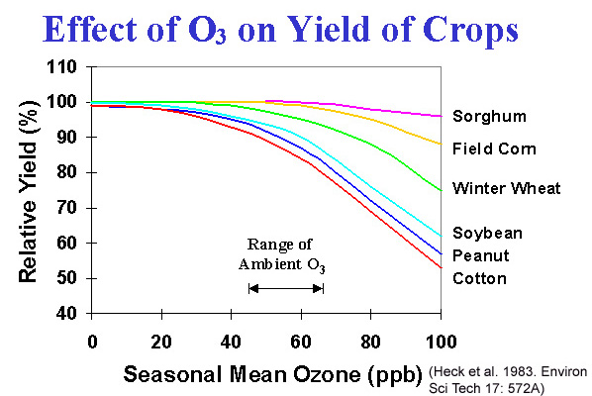
Agriculture
O₃ slowly interrupts the photosynthesis cycle and ultimately ‘suffocates’ the plant.
Plant growth will slow, increases risk of:
Disease and pollution injury
Bug infestations
Reproduction rates
Rice, soybean, corn, and wheat are very susceptible to ozone injury. Yield loss estimates are at about $14-$26 billion globally in a recent study
Notes:
When the apoplast fails to protect the plant from the toxins, the plant’s rate of photosynthesis slows and the plant ultimately just suffocates. When the plants are exposed to this kind of injury, the risks of disease, further injury, bug infestations, reproduction rates, etcetera, will begin to increase.
For example, ozone injury susceptible plants include rice, soybean, corn, and wheat. A recent study conducted by Ames Research Center estimates that globally, the total yield loss from these ozone susceptible plants are somewhere between 14 and 26 billion dollars. This study was a part of research conducted on which plants are ozone susceptible and which plants are better to breed under high ozone conditions
This image basically shows yield loss with respect to ozone concentration in parts per billion for very susceptible plants. As you can see there is a gradual decrease at around 40 ppb and then a steady drop off. This image came as a huge surprise to me since our exceedance standard is 70 ppb and at that concentration, there is a significant loss in crop yield.

Slide 5
Ecosystem Impacts
Loss of diversity
Habitat loss
Biomass loss
Changes to water and nutrient cycles (soil fertility)
Reduces carbon flow and leads to nitrogen fixation
Nitrogen run off into bodies of water (e.g. Chesapeake Bay, fish kills)
Notes:
Asphyxiant gases – nitrogen
The ecosystem impacts are actually quite significant. Ozone injury can lead to loss of plant diversity (which is a no brainer, survival of the fittest), and theres habitat and biomass loss in especially insect populations
Also, theres changes to water and nutrient cycles (aka soil fertility). Now I didn’t know this prior to my research and this blew me away. When the plant loses it’s ability to store food, carbon flow between the plant and soil from lack of photosynthesis is significantly reduced and the plants then resort to using nitrogen as an alternative. This then leads to nitrogen runoff from soils into bodies of water. Nitrogen is an asphyxiant gas and lead to hypoxia.
I like to play around on Google Earth and I figured Id share this image of the Chesapeake Bay I screendumped from the app with you. All the little fish skeletons indicate dead zones or areas of great fish kills.. And unfortunately, a lot of these icons represent hypoxic areas. This middle icon’s description is here and says, “Low oxygen levels increased from 1980 to 2000 and the area of hypoxia and anoxia has also increased. The events cause mortality at the sea bottom, although bottom dwelling species typically recover within a year. Crabs have also been found dead in fishers pots during hypoxic episodes”

Slide 6
National Ambient Air Quality Standards (NAAQS)
Primary: provide public health protection, including protecting the health of "sensitive" populations such as asthmatics, children, and the elderly
Secondary: provide public welfare protection, including protection against decreased visibility and damage to animals, crops, vegetation, and buildings
6 criteria pollutants: ozone, lead, particulate matter (PM10, PM2.5), sulfur dioxide, carbon monoxide, nitrogen dioxide
Current ozone standards (NAAQS)

Slide 7
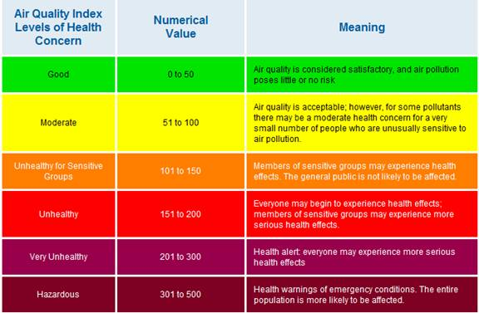
Air Quality Index (AQI)
#3
EPA’s index for reporting air quality
The higher the AQI value, the greater the level of air pollution and the greater the health concern
BP: break points (on your lab manual, pg 53)
I: index for pollutant p
Cp: rounded concentration of pollutant
$$I_{p}=\frac{I_{Hi}−I_{Lo}}{{BP}_{Hi}−{BP}_{Lo}}\left(C_{p}−{BP}_{Lo}\right)+I_{Lo}$$

Slide 8
Air Quality Index (AQI) Sample Calculation
#3
For ozone concentration of 30 ppb:
Ozone Breakpoints (ppm) | AQI
0.000 – 0.064 | 0 - 50
$$x_{ppm}=\frac{x_{ppb}}{1000 }$$
$$x_{ppm}=\frac{30 ppb}{1000 }$$
$$I_{p}=\frac{I_{Hi}−I_{Lo}}{{BP}_{Hi}−{BP}_{Lo}}\left(C_{p}−{BP}_{Lo}\right)+I_{Lo}$$
$x_{ppm}=$ 0.030 ppm
$$I_{p}=\frac{50−0}{0.064−0.000}\left(0.030 ppm−0.000\right)+0$$
AQI: Good, air quality is considered satisfactory, and air pollution poses little to no risk
$$I_{p}=23$$
HINT: look for your ozone concentration in ppb, convert to ppm, then find what range your concentration fits in in the breakpoints column.
SHOW YOUR WORK!

Slide 9
Calculating 8-hour O₃ averages
#2
$$8hr avg=\frac{{Cp}_{hr 1}+{Cp}_{hr 2}+{Cp}_{hr 3}+{Cp}_{hr 4}+{Cp}_{hr 5}+{Cp}_{hr 6}+{Cp}_{hr 7}+{Cp}_{hr 8}}{8}$$
Convert to ppm (conversion on previous slide) for your final answer!!!!
Do 12am to 4pm
You don’t need to calculate averages from 5pm to 11pm (see extra directions)
LAB FREEBIE using chart given in manual/extra directions at 12am:
$${12am}_{8hr}=\frac{49 ppb+45 ppb+41 ppb+47 ppb+20 ppb+19 ppb+24 ppb+42 ppb}{8}$$
$${12am}_{8hr}=35.88 ppb → \frac{35.88 ppb}{1000}≈0.0359 ppm$$

